Slide 1
High-Power Near-Ballistic Uni-Traveling Carrier Photodiode with Ultra-Fast Switching Characteristic for Wireless Communication and High-Resolution 3-D Radar Imaging
Speaker: Prof. Jin-Wei Shi

Slide 2
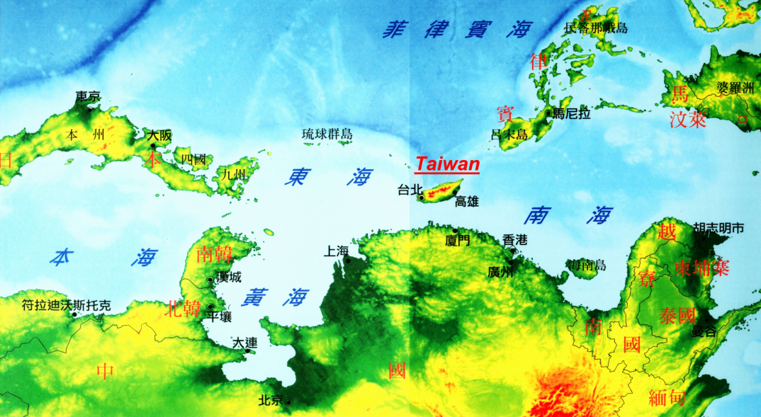

National Central University

Slide 3


Acknowledgement
Notes:
3
3

Slide 4
Outline
Introduction
Working Principle of NBUTC-PD
High-Power and Ultrafast Modulation Characteristic
Applications for Communication and Radar Imaging
Conclusion

Slide 5
MMW Window for Wireless Transmission
atmospheric peak
W-band: broadband and less dispersion
60 GHz occurs at an atmospheric peak, meaning that transmission distance is limited.
70/80 GHz occurs in an atmospheric window permitting multiple kilometer transmissions.
Jonathan Wells “Fast Than Fiber: The Future of Multi–Gb/s Wireless,” IEEE Microwave Magazine, pp.104–112, May 2009.

Slide 6
Ultra-fast photodiodes: The missing link between wireless and optical networks
Simpler Base station
Synchronized Carrier
High-Power MMW PD are key components!!

Slide 7


Some Reported Solution-
Uni-Traveling Carrier Photodiode
UTC-PD*
Pin PD
Absorption layer
( P-doping)
Absorption layer
( intrinsic)
Anode
Anode
CB
VB
CB
VB
Diffusion block
Cathode
Cathode
Charge Storage
Electron Dominated Space-Charge Screening Effect !!
Hole Dominated Space-Charge Screening Effect !!
J_{max} ≈ (V_{bias}+ø)εV_{carriers} / D²
V_{hole} << V_{electron}
J_{max UTC} >> J_{max pin}
* H. Ito, S. Kodama, Y. Muramoto, T. Furuta, T. Nagatsuma, T. Ishibashi, “High-Speed and High-Output InP-InGaAs Unitraveling-Carrier Photodiodes,” IEEE J. of Sel. Topics in Quantum Electronics, vol. 10, pp.709-727, Jul./Aug., 2004

Slide 8
How to obtain more bandwidth ?
Tadao Nagatsuma Ho-Jin Song, and Yuichi Kado,"Challenges for Ultrahigh-Speed Wireless Communications Using Terahertz Waves,"Terahertz Science and Technology,Vol.3, No.2, June 2010

Slide 9
Sub-THz UTC-PD…..
Tadao Nagatsuma Ho-Jin Song, and Yuichi Kado,"Challenges for Ultrahigh-Speed Wireless Communications Using Terahertz Waves,"Terahertz Science and Technology,Vol.3, No.2, June 2010

Slide 10
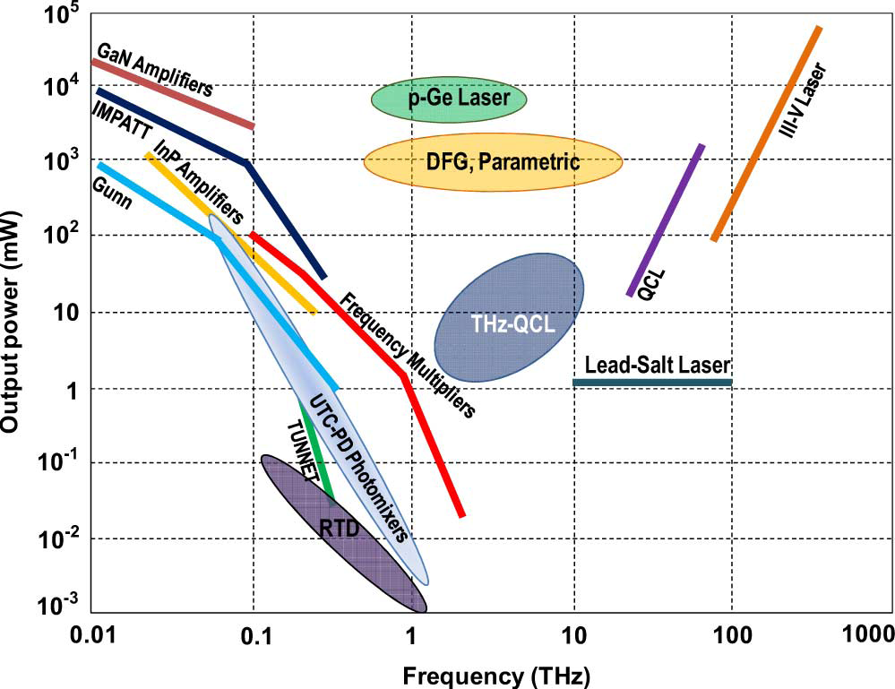
Limited Power from Sub-THz PD…..
Good: Lossless optical interconnect
Bad :Less than 1mW at ~300 GHz regime
How to get more power (> 1mW) in sub-THz regime ?
Goutam Chattopadhyay, "Technology, Capabilities, and Performance of Low Power Terahertz Sources", IEEE TRANSACTIONS ON TERAHERTZ SCIENCE AND TECHNOLOGY, VOL. 1, NO. 1, SEPTEMBER 2011

Slide 11
Outline
Introduction
Working Principle of NBUTC-PD
High-Power and Ultrafast Modulation Characteristic
Applications for Communication and Radar Imaging
Conclusion

Slide 12


Why UTC-PDs Saturate?
(Field Screening)
(Space Charge Screening)
V_{eff} :minimum reverse bias voltage during dynamic operation
-
Veff
+
V_{bias} :external bias voltage
V_{bi} :built-in potential
P
J_{max} :maximum output photocurrent
i
R(Load)
A :active area
R :load resistance
N
F :fRC roll-off factor
Ddep
E_{c} :critical field
V_{e} : over-shoot drift-velocity
-
Vbias
+
ε :dielectric constant
D_{dep} :depletion layer thickness

Slide 13
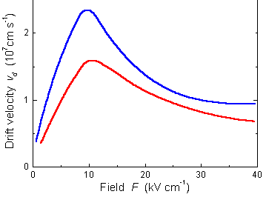
Case I:fT>>f3dB (Not sub-THz regime)
(Field Screening)
(Space Charge Screening)
Minor
(3)
(Thermal Degradation/Failure)
High-bias and good heat-sinking is necessary for high power

Slide 14
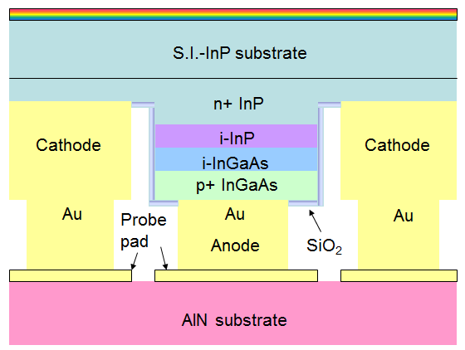
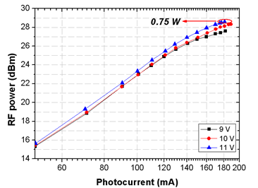
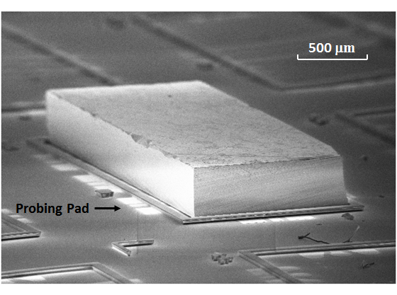
Case I: fT>>f3dB
(State-of-the-art High-Power Performance at 15 GHz)
180mA, 15GHz, 2700mA-GHz under 10ºC
But how about Sub-THz regime?
Zhi Li, Yang Fu, Huapu Pan, Andreas Beling, Joe C. Campbell, “Photodiode with 0.75 W RF Output Power at 15 GHz”, ECOC 2011

Slide 15
Case II:fT~f3dB (Sub-THz Regime)
(Field Screening)
(Space Charge Screening)
Serious issue!!
(3)
(Thermal Degradation/Failure)
You need a thin UTC-PD to attain sub-THz transient time
P
I
P
I
N
N
Substrate
Substrate

Slide 16
Case II:fT~f3dB (Sub-THz Regime)
(Field Screening)
(Space Charge Screening)
Serious issue!!
(3)
(Thermal Degradation/Failure)
Device Heating
You need a thin UTC-PD to attain sub-THz transient time
P
Also, you need a small size to sustain a sub-THz RC-limited bandwidth
P
I
I
N
N
Substrate
Substrate

Slide 17
Miniaturized PD: Heat is the killer !!
(Field Screening)
(Space Charge Screening)
(Thermal Degradation/Failure)
300K
Device Heating
500K
P
Serious Degradation on Overshoot Drift Velocity!
I
N
Substrate
Fawcett, W. and G. Hill, Electron. Lett 11, 4 (1975) 80-81.

Slide 18
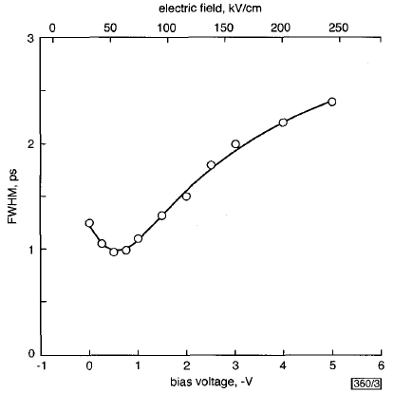
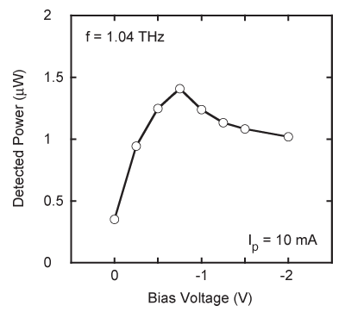
Sub-THz regime: High-Bias Works ?
Pulse Measurement(No heating) Under 12.5ΩLoad
CW Measurement (Heating)
External saturation effect ?
Best Speed Performance for Maximum output power
~0.7V for Best Speed Performance
Increasing V_{bias} doesn’t work (Intervalley scattering/Heat issue !!)
A small optimum V_{bias} (External circuit Saturation effect)
H. Ito, T. Furuta, S. Kodama and T. Ishibashi,"InP/lnGaAs uni-travelling-carrier photodiode with 310GHz bandwidth", ELECTRONICS LETTERS 12th October 2000 Vol. 36 No. 21
H. Ito, T. Furuta, F. Nakajima, K. Yoshino and T. Ishibashi,"Photonic Generation of Continuous THz Wave Using Uni-Traveling-Carrier Photodiode", JOURNAL OF LIGHTWAVE TECHNOLOGY, VOL. 23, NO. 12, DECEMBER 2005

Slide 19
How to Further Increase Power in Sub-THz Regime?
(Field Screening)
Possible!
Limited by fRC
(Space Charge Screening)
Material
(3)
(Thermal Degradation/Failure)
How to increase Veff in the same Thickness (Ddep) without seriously sacrificing Ve (less heating)??
Let Near-ballistic transport happens in the higher V_{bias} regime !!

Slide 20

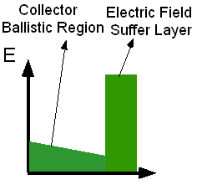
Our Soultion: The NBUTC-PD
Low field in the collector Near Ballistic Transport(~Ve)
High Veff (External bias) Minimize the external screening effect
Collector
Velocity overshoot
(120nm)
Charge layer
(20nm)
-
Veff
+
T. Ishibashi and Y. Yamauchi, “A possible near-ballistic collection in an AlGaAs/GaAs HBT with a modified collector structure,” IEEE Trans. Electron Devices, vol. 35, no. 4, pp. 401–404, Apr. 1988.

Slide 21
Outline
Introduction
Working Principle of NBUTC-PD
High-Power and Ultrafast Modulation Characteristic
Applications for Communication and Radar Imaging
Conclusion

Slide 22
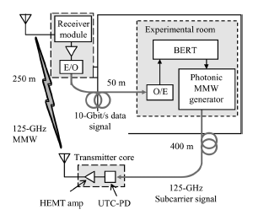
Why we need high-power PD ?
High Power O/E converting
module is required!
10Gbit/s Data transmission at 120GHz
for >250m has been demonstrated!!
Akihiko Hirata, Hiroyuki Takahashi, Ryoichi Yamaguchi, Toshihiko Kosugi,Koichi Murata, Tadao Nagatsuma, Naoya Kukutsu, and
Yuichi Kado, “Transmission Characteristics of 120-GHz-BandWireless Link Using Radio-on-Fiber Technologies,”
JOURNAL OF LIGHTWAVE TECHNOLOGY, VOL. 26, NO. 15, AUGUST 1, 2008

Slide 23
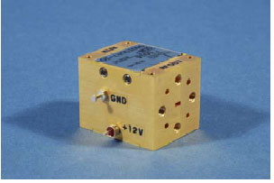
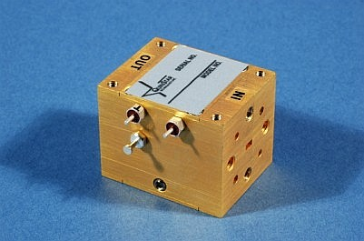
Costly MMW Electrical Amplifier (>100GHz) Operating Frequency
15dB
Max Output
Power: 13dBm
EDFA
High Power PD
Costly
RF Globalnet(http://www.rfglobalnet.com)
QuinStar (http://www.quinstar.com)

Slide 24
The breakthrough of NBUTC-PD:
Geometrical Structure of PD array
Optical MMW Source
Good Heat-Sinking for Sub-THz Operation

Slide 25
Combined Several Devices: Traveling- Wave PD (TWPD)
V₀
V₁
V₂
V_{N}
Dummy Load
Drawback
3dB photo-generated MMW power is sacrificed Dummy Load
Bragg cut-off limited bandwidth Periodic Structure
How can we overcome
these drawbacks ?
The net bandwidth is limited by Single PD
Transmission Loss limited bandwidth Major Bandwidth Limitation

Slide 26
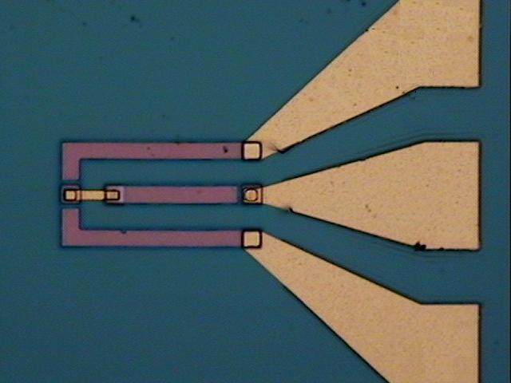
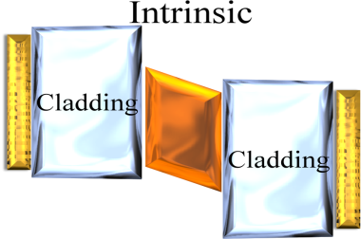
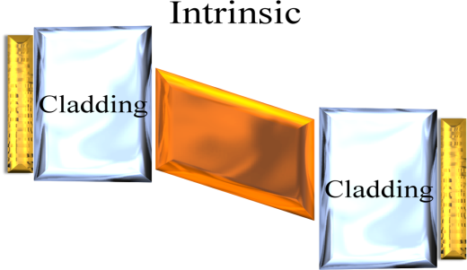
Our Solution: Cascade NBUTC-PD
Series of several high-speed PDs
R_{Load}
125μm
Short carrier drift time !!
R_{Load}
I_{toatal}
Capacitance equal to….
Active area
A thin depletion layer (Short carrier drift-time) with a released RC-bandwidth !!
Dummy load and complex E-O design are both not necessary !! (50Ω load)

Slide 27
How about high-power performance of cascade PD?
Will the increase of series resistance be a issue? R nR ?
<
Improve RC-limited bandwidth
by use of cascade structure !!
D_{N}
(nR+50)*C/n
(R+50)*C
Cascade Structure:
V_{bias}
R_{Load}
D₂
➔ Although current can’t increase as parallel (TWPD), we can increase size of single-PD for the desired bandwidth to enhance saturation current due to reduction of capacitance.
I_{toatal}
D₁
➔ Although V_{bias ,}Total area thermal problem ~

Slide 28
Power Performance
Measured Saturation Current-Bandwidth Product is record high as “7500mA-GHz” (100GHz, 75mA)
The Output Power Performance of our
2-Cascade-NBUTC-PD is superior to
UTC-PD+HEMT Amplifier Module!!
Record high saturation current-bandwidth product (7500mA-GHz, 91GHz) under a 50Ω load.
Akihiko Hirata, Hiroyuki Takahashi, Ryoichi Yamaguchi, Toshihiko Kosugi,Koichi Murata, Tadao Nagatsuma, Naoya Kukutsu, andYuichi Kado,
“Transmission Characteristics of 120-GHz-BandWireless Link Using Radio-on-Fiber Technologies,” JOURNAL OF LIGHTWAVE TECHNOLOGY, VOL. 26, NO. 15, AUGUST 1, 2008

Slide 29
Benchmark for High Power PD
 | Bandwidth (GHz) | Saturation current & Bandwidth Product (mA*GHz)
Parallel-fed TWPD (p-i-n PD) [1] | 80 | 1760mA۰GHz
Parallel-fed TWPD (UTC-PD) [2] | 17 | 1938mA۰GHz
Single UTC-PD [3] | 170 | 2380mA-GHz
Single CCUTC-PD [4] | 50 | 2500mA.GHz
Cascade NBUTC-PD [this work] | 100 | 7500 mA۰GHz
A. Beling, J. C. Campbell, H.-G. Bach, G. G. Mekonnen, and D. Schmidt, “Parallel-Fed Traveling Wave Photodetector for >100-GHz Applications,” J. of Lightwave Technol., vol. 26, pp. 16-20, Jan., 2008
A. Beling, H. Chen, H. Pan, and J. C. Campbell, “High-Power Monolithically Integrated Traveling Wave Photodiode Array,” IEEE Photon. Technol. Lett., vol. 21, Dec., pp.1813-1815, 2009.
3. H. Ito, T. Furuta, F. Nakajima, K. Yoshino, T. Ishibashi, “Photonic generation of continuous THz wave using uni-traveling-carrier photodiode,” J. of Lightwave Technol., vol. 23, pp. 4016-4021, Dec., 2005.
4. N. Li, X. Li, S. Demiguel, X. Zheng, J. C. Campbell, D. A. Tulchinsky, K. J. Williams, T. D. Isshiki, G. S. Kinsey, and R. Sudharsansan, “High-Saturation-Current Charge-Compensated InGaAs-InP Uni-Traveling-Carrier Photodiode,” IEEE Photon. Technol. Lett., vol. 16, Mar., pp.864-866, 2004.

Slide 30
The breakthrough of NBUTC-PD:
Geometrical Structure of PD array
Optical MMW Source
Good Heat-Sinking for Sub-THz Operation

Slide 31
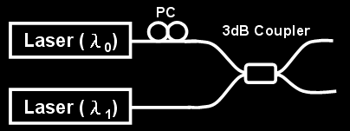
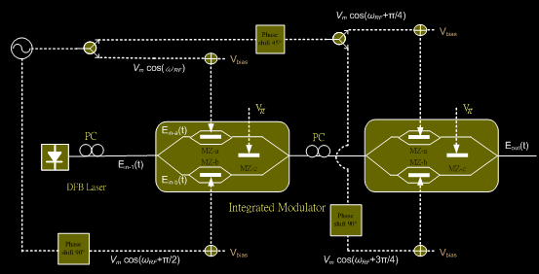
The Optical MMWs Source
Two Lasers
The heterodyne beating optical signal is too noisy and unstable
Larger Phase noise than that of homo-dyne
Single Laser
The homodyne system by using 8f (12f) technique
*Much more stable and pure MMWs signal
*Po-Tsung Shih, Chun-Ting Lin, Wen-Jr Jiang, Er-Zih Wong, Jason (Jyehong) Chen, Sien Chi, Y.-S. Wu, F.-M. Kuo, Nan-Wei Chen, and J.-W. Shi, “W-Band Vector Signal Generation via Optical Millimeter-Wave Generation and Direct Modulation of NBUTC-PD,” Proc. OFC 2009, San Diego, CA, USA, March, 2009, pp. OWP4.

Slide 32
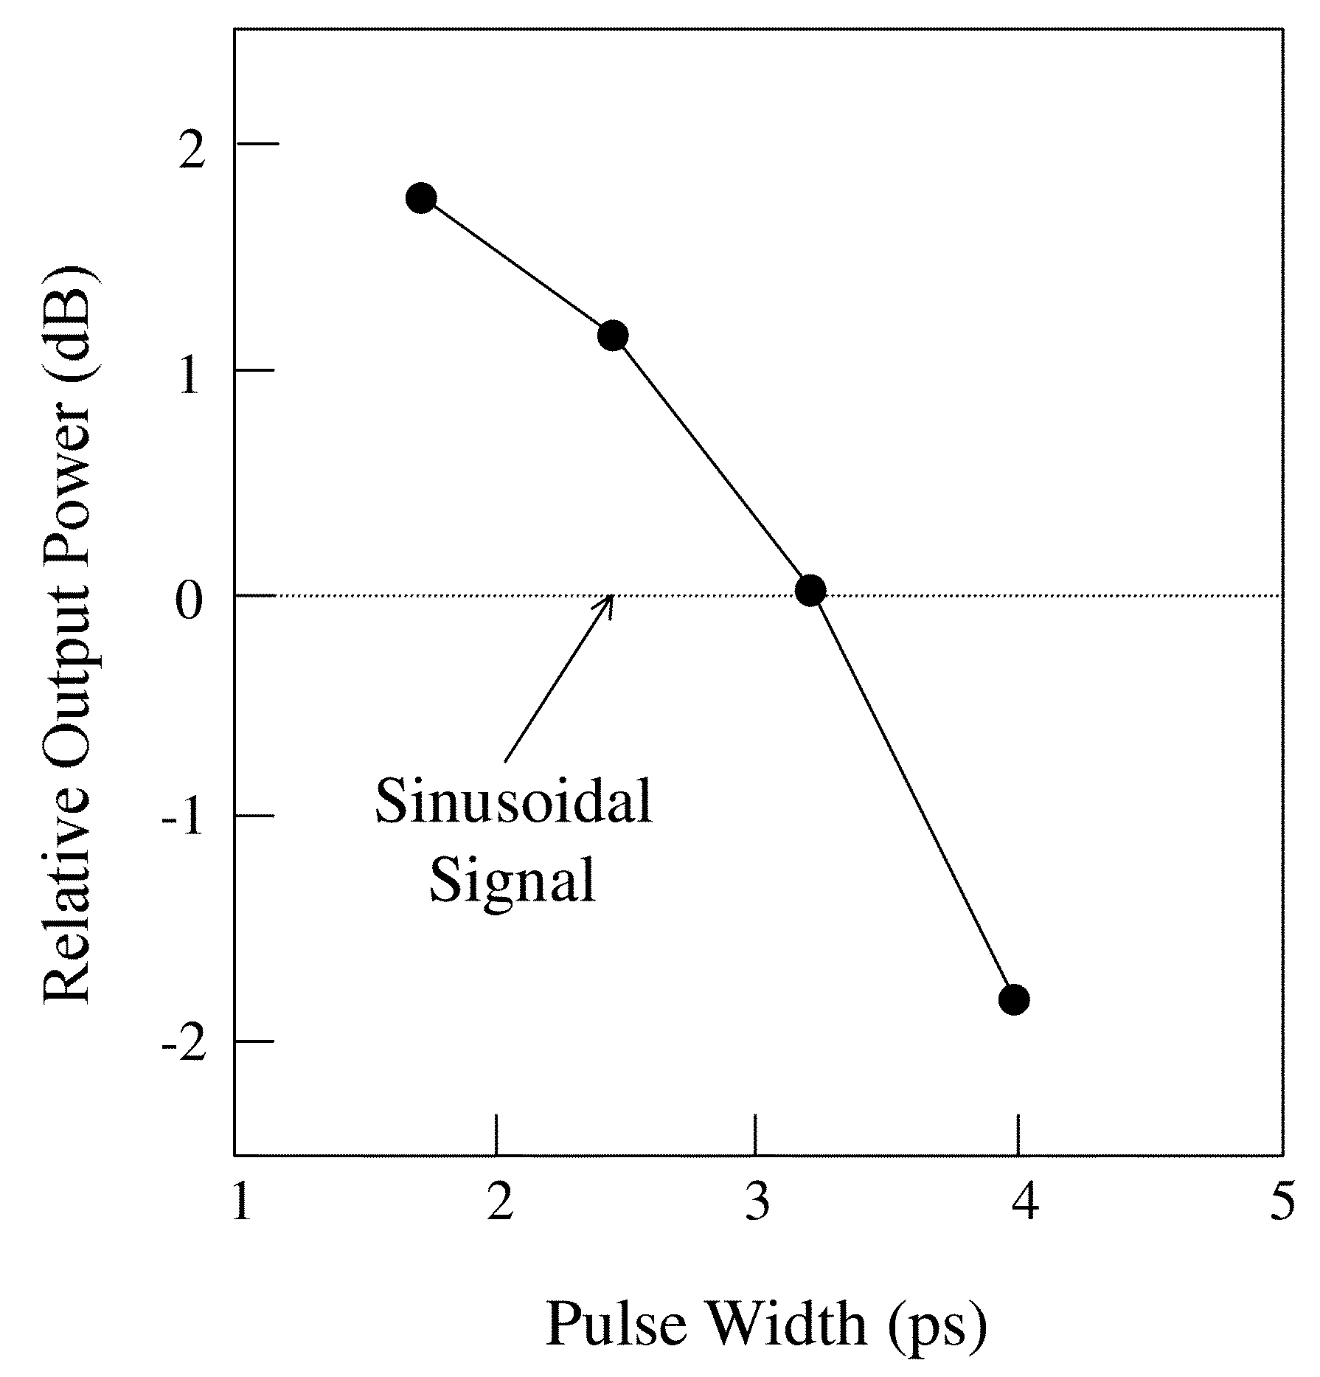
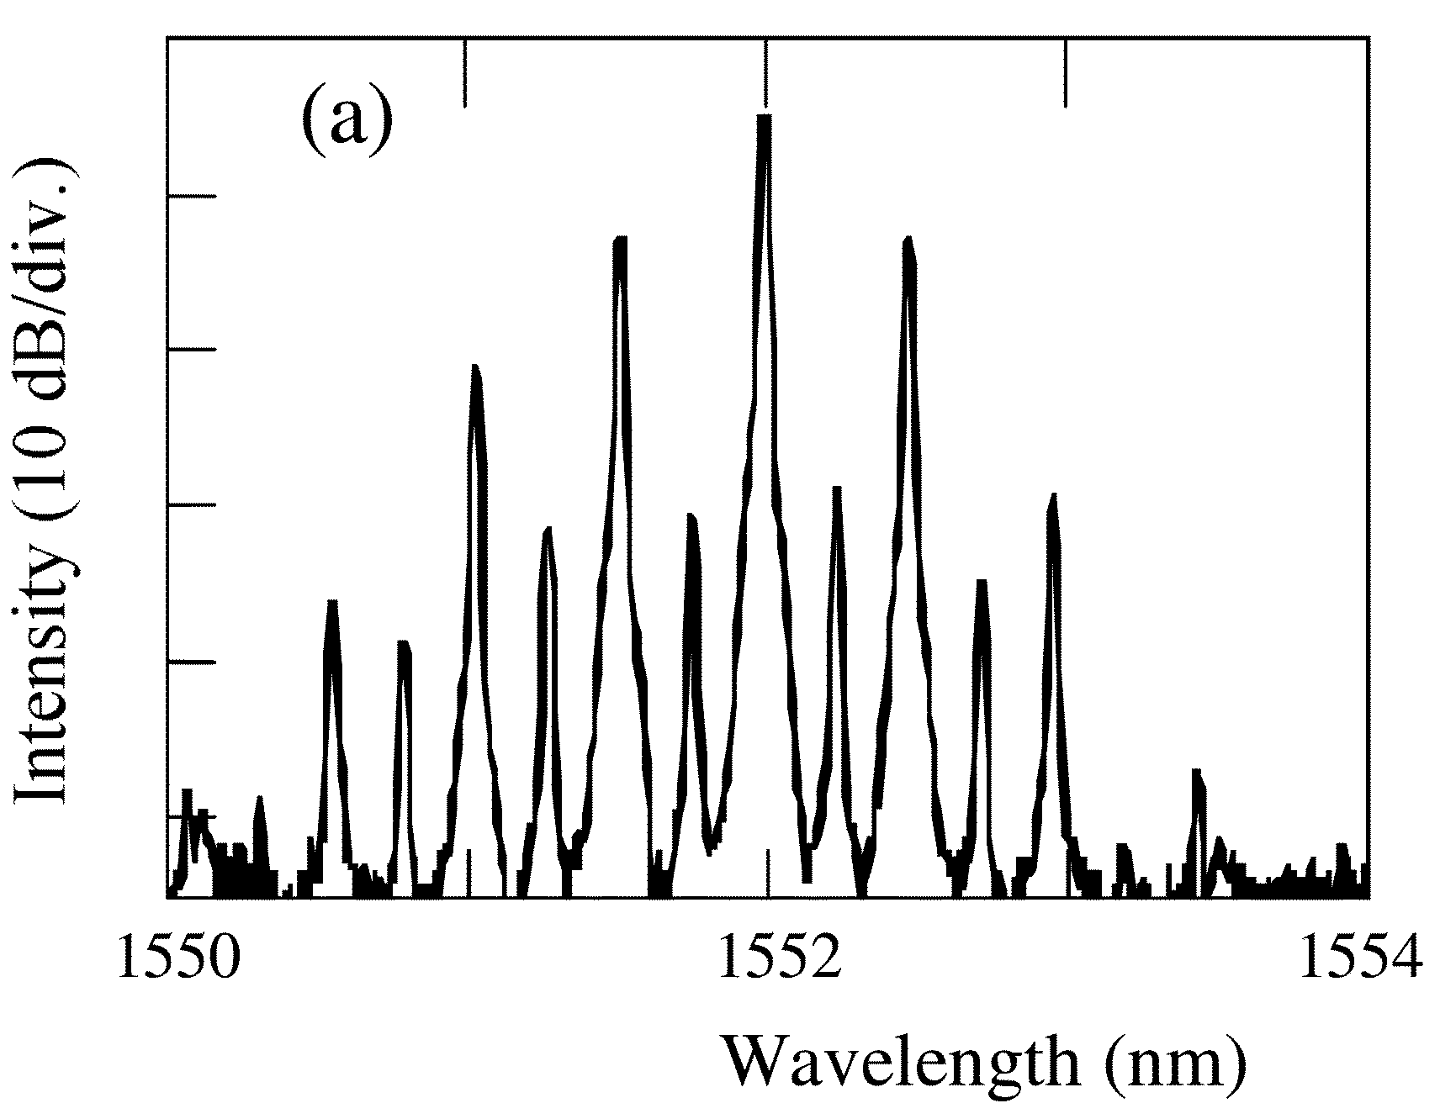
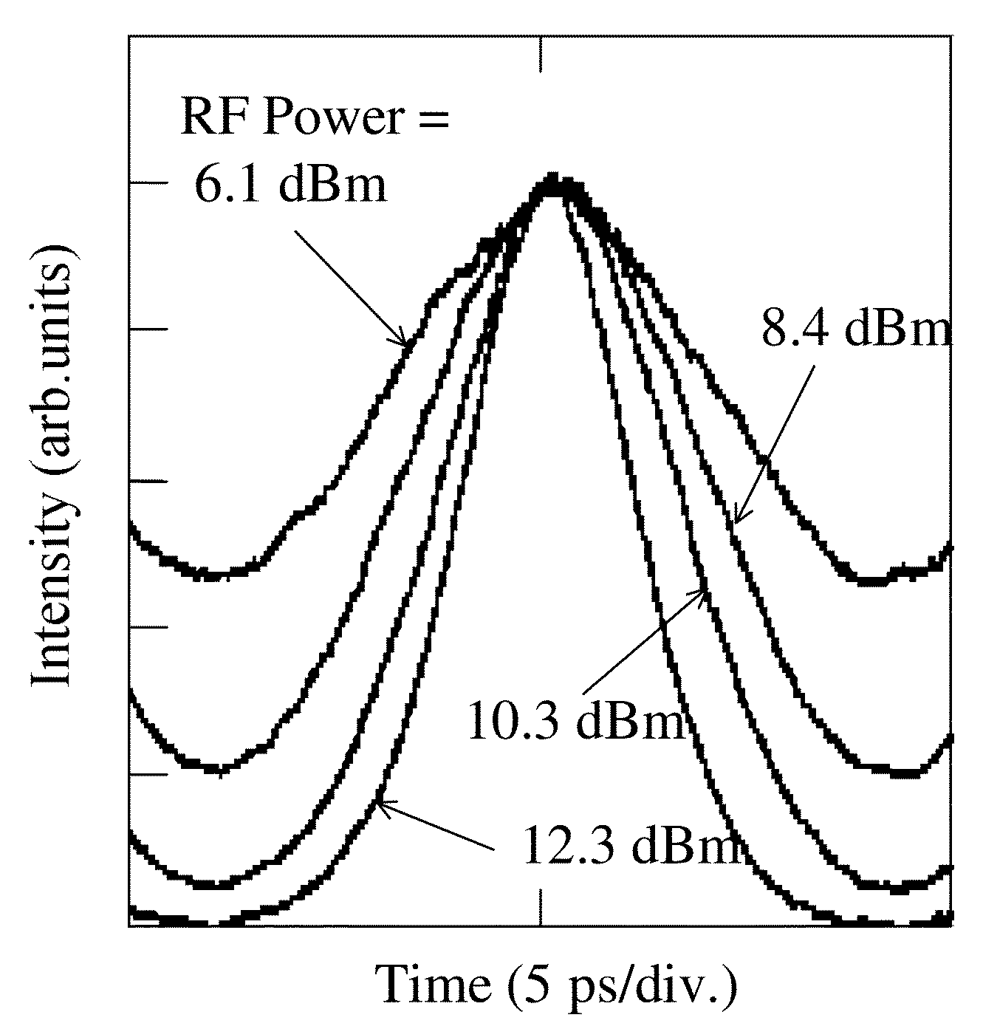
Another way for high MMW Power: Optical MMW Short Pulse Source
Shorter Pulse Provide Higher MMW Power!!
Akihiko Hirata, Mitsuru Harada, and Tadao Nagatsuma,"120-GHz Wireless Link Using Photonic Techniques for Generation, Modulation, and Emission of Millimeter-Wave Signals,"J. of Lightwave Technol., vol. 21, pp. 2145–2153 ,2003.

Slide 33
Adaptive Photonic MMW Source for Access Network
Generate 1-ps optical pulse train (~400 GHz rept. rate) for higher MMW power!!
Indepently Manipulate Phase and Amplitude of each comb line!!

Slide 34
Record-High Photo-Generated 124 GHz MMW Power: Optical MMW Short Pulse Source
MMW Power increases with number of comb lines (pulse width shortening)
15 dBm, 31 mW
Record-high MMW power (31 vs. 20 mW (UTC-PD))

Slide 35
The breakthrough of NBUTC-PD:
Geometrical Structure of PD array
Optical MMW Source
Good Heat-Sinking for Sub-THz Operation

Slide 36
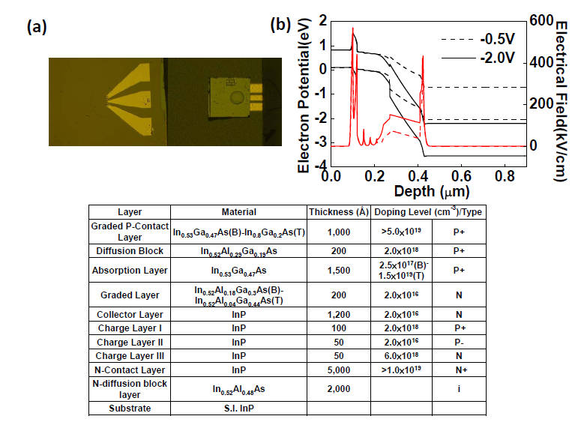
Sub-THz Regime: Ultra-Short Transient Time and Good Heat-Sinking
Au-Au Bonding (Excellent thermal conductivity)
Thin collector layer: 155nm
f_{T}: 750 GHz !!

Slide 37
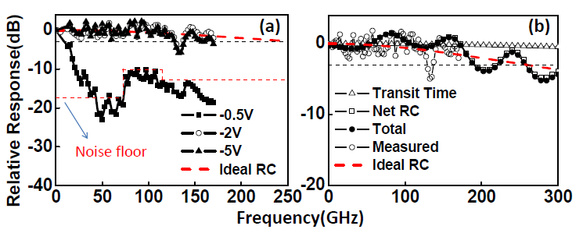
Ultra-wide O-E Bandwidth (~300 GHz)
Measured Bandwidth up to 170 GHz
Optimum bias: -2V (O-E f_{3dB} > 170 GHz)
Extrapolated 3dB (by modeling): ~250 GHz

Slide 38
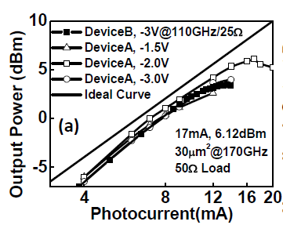
MMW power measurement results
Optimum bias
Optimum bias
Optimum bias: NBUTC-PD vs. UTC-PD (-2V vs. -0.75V)
Can minimize external circuit saturation effect (Just 50 Ohm load)

Slide 39
Potentially Superior Sub-THz Output-Power Performance to UTC-PD
> 1mW sub-THz power (300-500 GHz) should be possible !!
Goutam Chattopadhyay, "Technology, Capabilities, and Performance of Low Power Terahertz Sources", IEEE TRANSACTIONS ON TERAHERTZ SCIENCE AND TECHNOLOGY, VOL. 1, NO. 1, SEPTEMBER 2011

Slide 40

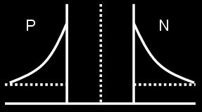
Significant Bias Dependent Speed Performance: Switch !!
Under reverse bias still has high nonlinearity!!
Without minority carrier injection under forward bias voltage
Very-high modulation speed!!

Slide 41
High On/Off Ratio
1.1V
20dB
>36dB

Slide 42
High On/Off Ratio
Current doesn’t change during switching!!
>36dB

Slide 43
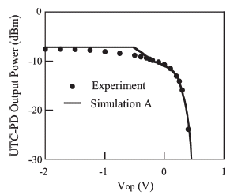
High On/Off Ratio
Best MMW Switch: High on/off ratio, Ultra-fast switching speed, low-driving voltage
>36dB
NTT’s UTC-PD
A. Hirata, T. Furuta, H. Ito, and T. Nagatsuma, “10-Gb/s Millimeter-Wave Signal Generation Using Photodiode Bias Modulation,” J. of Lightwave Technol., vol. 24, pp. 1725–1731, April. 2006.
Forward

Slide 44
Outline
Introduction
Working Principle of NBUTC-PD
High-Power and Ultrafast Modulation Characteristic
Applications for Communication and Radar Imaging
Conclusion

Slide 45
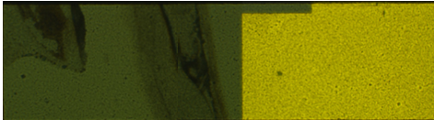
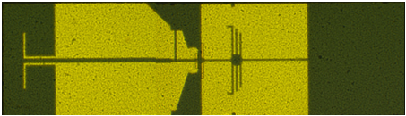
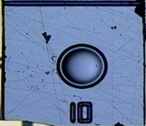
How to achieve a ultra-wideband photonic transmitter
For system application, you need WR-10 waveguide excitation…….
3mm
Backside
Inserted into
WR-10
Waveguide
(RF output)
Topside
1.24mm
Electrical
IF Input
Optical LO Input

Slide 46
How to achieve a ultra-wideband photonic transmitter
Up-converted RF output
Feed into
WR-10
Waveguide
Optical LO Input
Electrical
IF Input
Quasi-Yagi
Feeding Antenna
W-band
Bandpass Filter
W-band
Bandstop Filter
>10dB

Slide 47
Measure Result of Entire Module
3dB
>25GHz
>50GHz
High fractional bandwidth (68-128GHz, >61.2%)
Record-High IF modulation Bandwidth (>25GHz)

Slide 48
Power Performance
18mA, 6.3dBm
Improved Power performance due to better Heat-sinking

Slide 49
1st Application: Photonic MMW Radar System

Slide 50
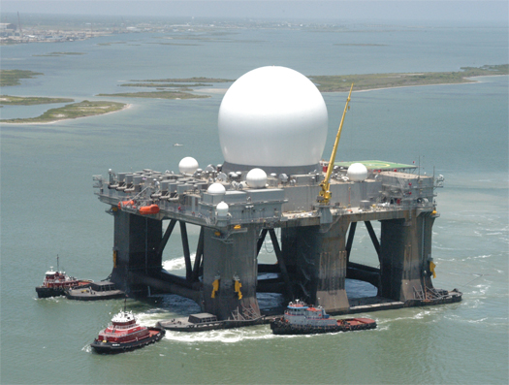
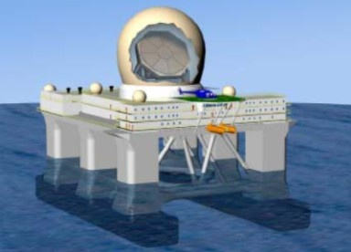
Radar Industry Development
Military Industry
US Considers to install another
X-Band Radar in Japan - Morimoto
High resolution
High Elevation Ballistic Missile Defense System
Sea Base X-band Radar

Slide 51
Active Radar Imaging System
Signal Source
CW Radar System
Pulse Radar System
Chirp Radar System

Slide 52
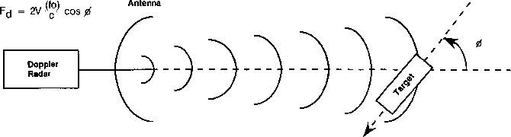
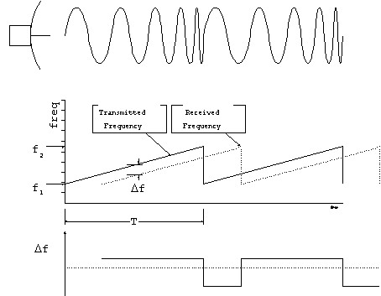
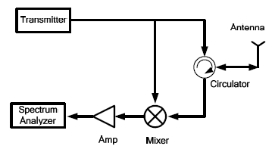
CW Radar System
Doppler Radar
Mark：AM、FM or PM
FMCW Radar

Slide 53
CW Radar System
Advantage：
Easy and Direct Way
High Available Power
Disadvantage：
Need Mark for 3D Imaging
Resolution depends on Scanning Bandwidth

Slide 54
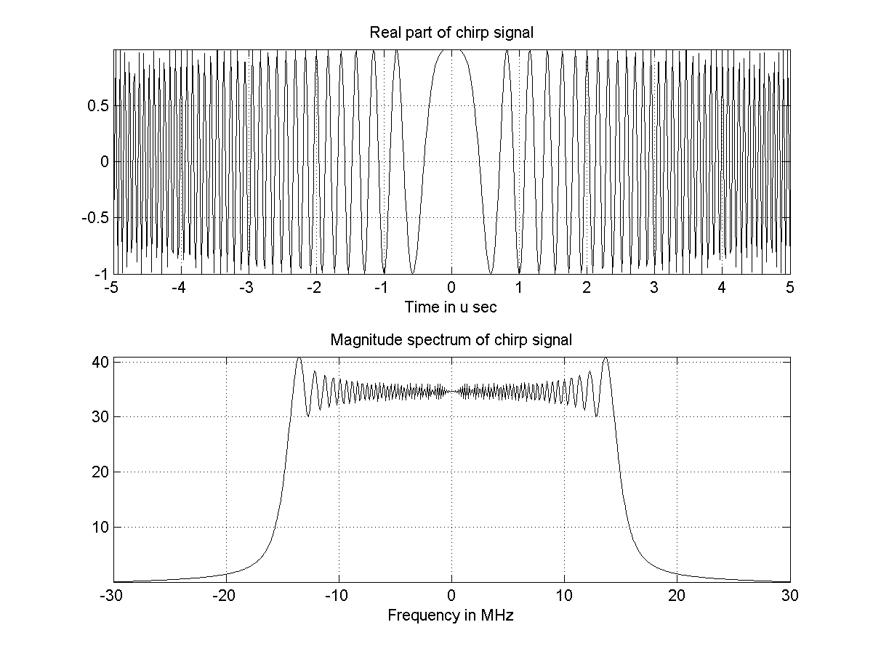
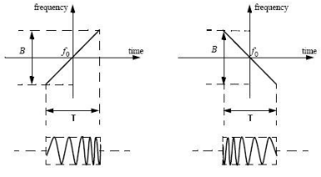
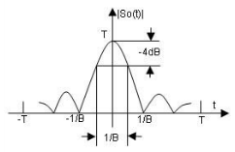
Chirp Pulsed Radar System
Trade off： Resolution Distance
(narrow wide pulse width)
Transmission
Receiving
Pulse Compression
Matched Filter
FM Chirp Pulse
Big Average Power
Compressed Narrow Pulse

Slide 55
Our Previous work: Photonic Chirp pulse Generation

Slide 56
“Record-high” Compression ratio of Chirped Pulse at W-band
Record high compression ratio (B*T) of Chirped pulse (14 GHz, 50 μs, 7*10^5)

Slide 57
Chirp Pulsed Radar System
Advantage：
Higher Resolution
High available Power
Long Distance
Disadvantage：
Need Match Filter and complicated DSP

Slide 58
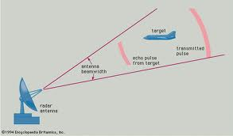
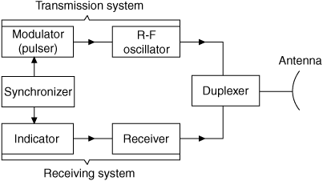
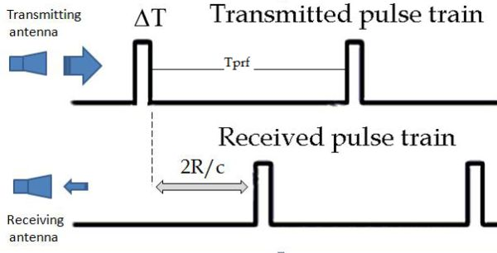
Pulsed Radar System

Slide 59
Pulsed Radar System
Advantage：
Direct Way
Higher Resolution
Disadvantage：
Short Distance (Low Average Power)
High Peak Power
System Interference

Slide 60
Radar Imaging System
Purpose： 1.High Resolution
What’s the solution of high resolution (short pulse width) pulse?
Time Domain Spectroscopy (TDS)

Slide 61
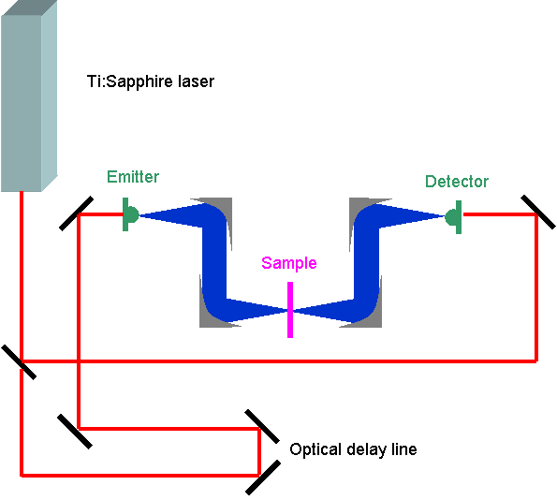
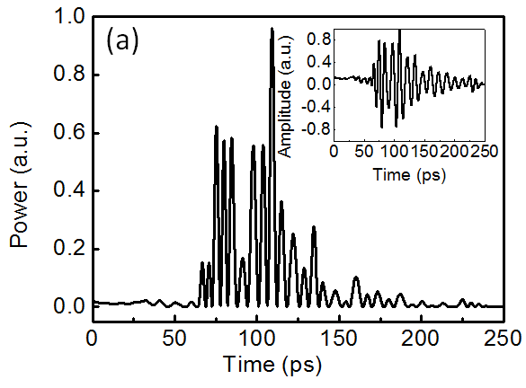
Time Domain Spectroscopy System
Transmitting Through Waveguide
Low Power
Distortion and Loss
Can’t Remote Sensing
Sub Picosecond Pulse
Gating Slow
Not Suitable For Radar System

Slide 62
Radar Imaging System
Purpose： 1.High Resolution
2.High Frame Rate
Pulse Radar System
Short Pulse Width
Less DSP

Slide 63
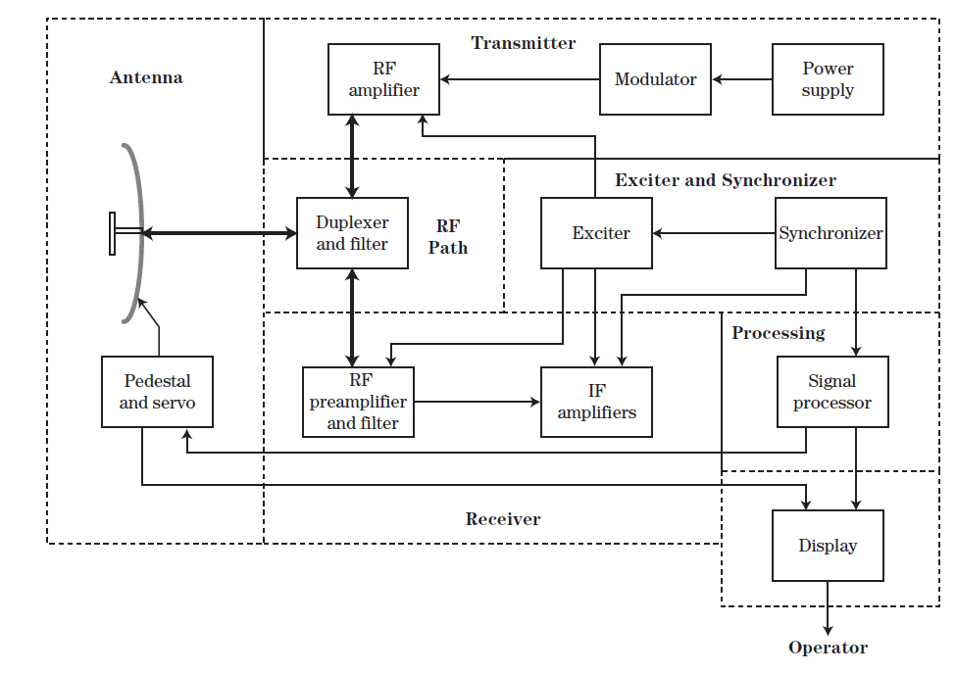


Typical Pulse Radar System
High Peak Power
Low Average Power
Short Distance
Interference & Reflection

Slide 64
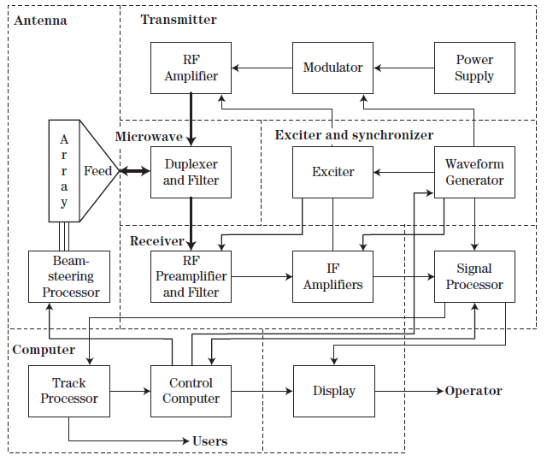
Typical Phase Array Radar System
High Peak Power
Power from Solid State Amplifier is not Enough
High Power
(Hundreds
of kW)
Magnetron
Oscillator
Bulky and Narrow-Band Circulator
Cross Talk & Reflection
Photonic Short
Pulse Generator
Solution：
I/O Problem

Slide 65
Typical Phase Array Radar System
Electrical Out
Optical In
Few Cycle MMW Short Pulse
Lossless in Optical Fiber
Good Isolation
Reduce the I/O Problem
O/E Transform Loss

Slide 66
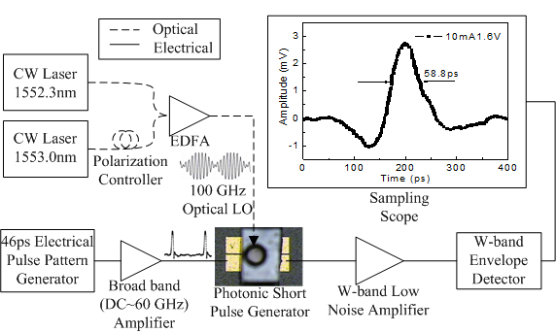
Photonic MMW Short Pulse Generator
Not femtosecond Mode Lock Laser
Beating Signal
Few Cycle MMW
Short Pulse
Bias Modulation
Notes:
Photonic MMW Short Pulse Generator

Slide 67
Radar Imaging System
Receiver
B.
A.
Detected Target
(Focus Point)

Slide 68
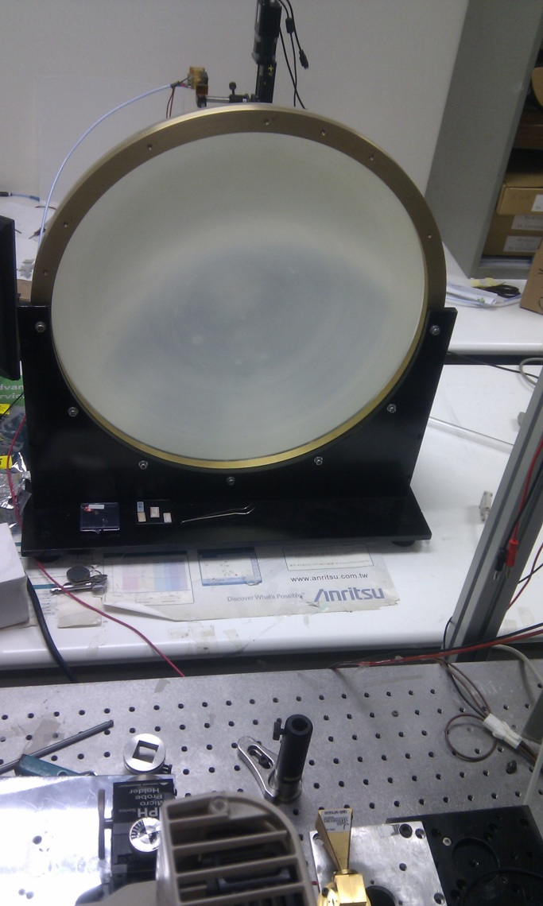
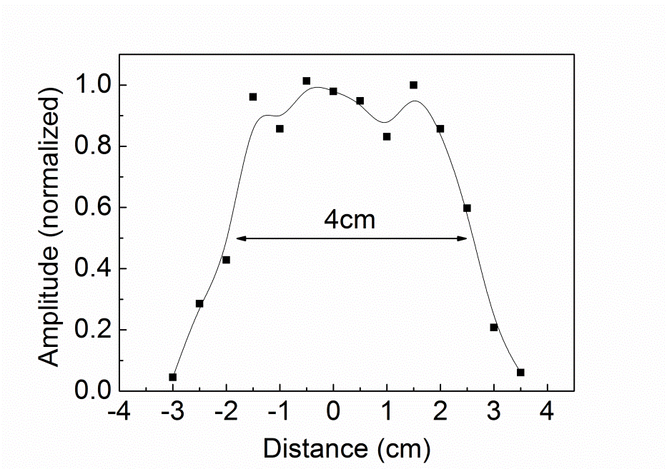
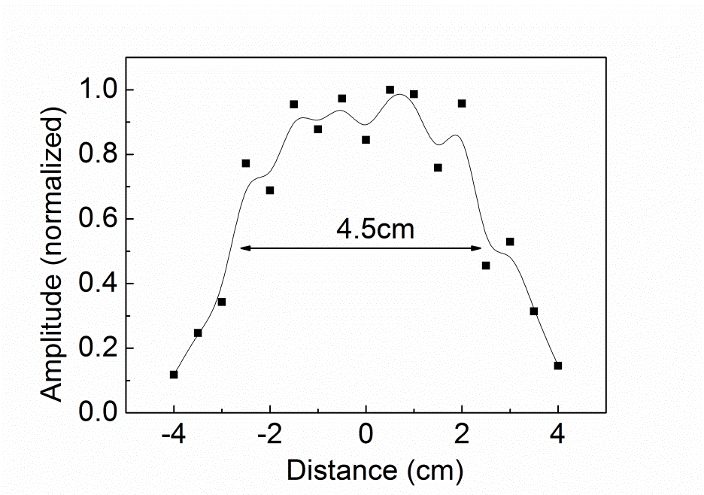
Resolution Measurement
Temporal Resolution
Receiving Horn
1.053 cm
MMW Lens
Transmitting Horn
Spot Size
Spatial Resolution

Slide 69

Object Image Measurement
Security Check
Envelope
Object Under Test

Slide 70
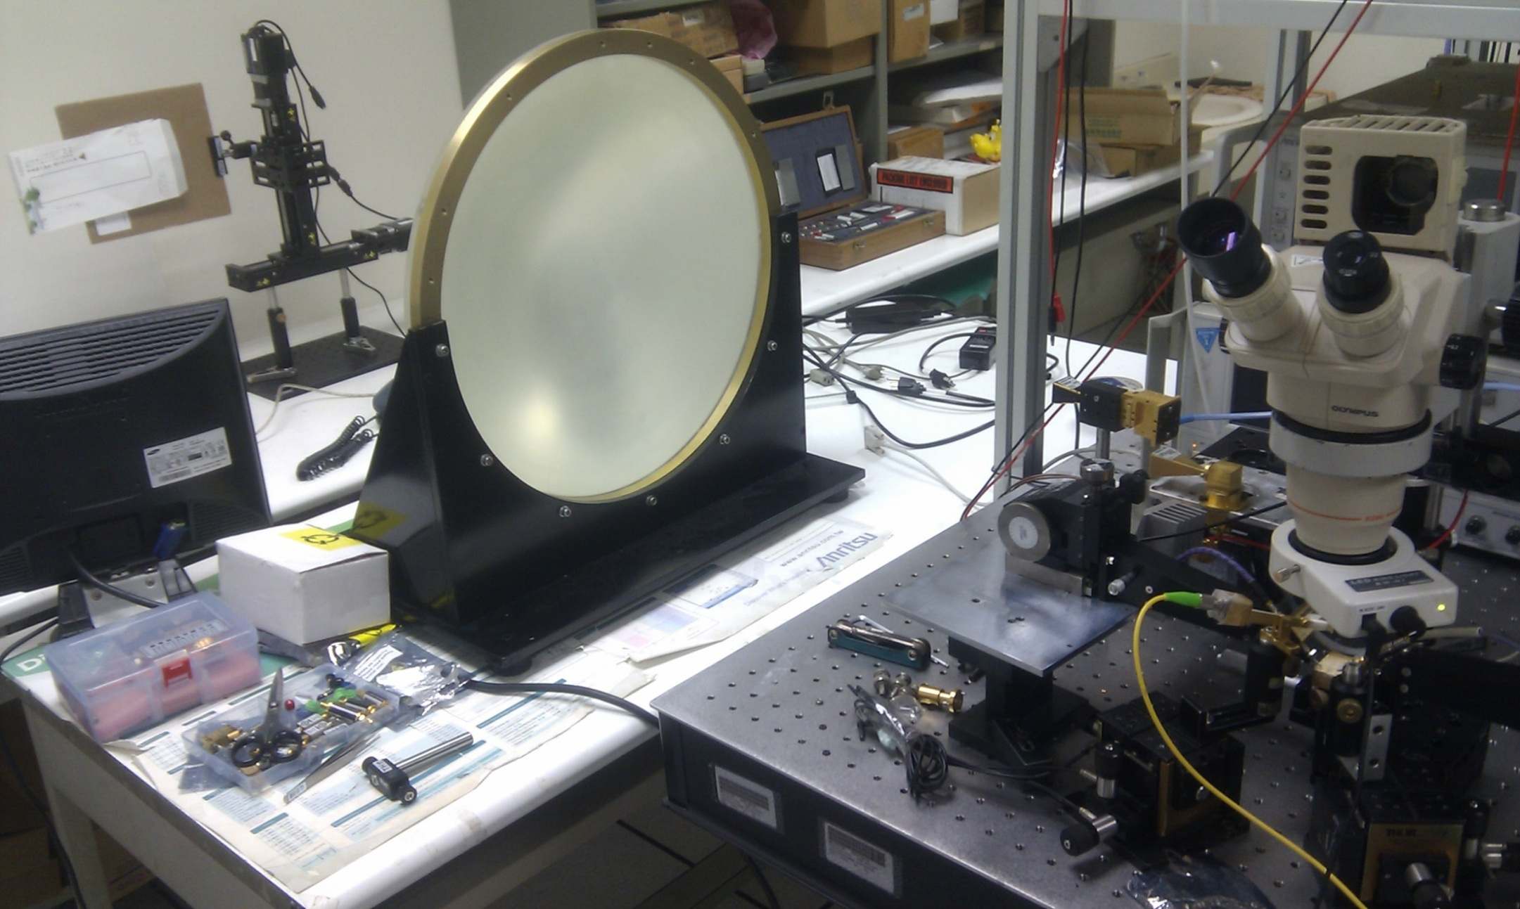
Object Image Measurement
Object Under Test
Receiving Horn Antenna
Transmitting Horn Antenna
Millimeter Wave Lens
Photonic Short
Pulse Generator

Slide 71
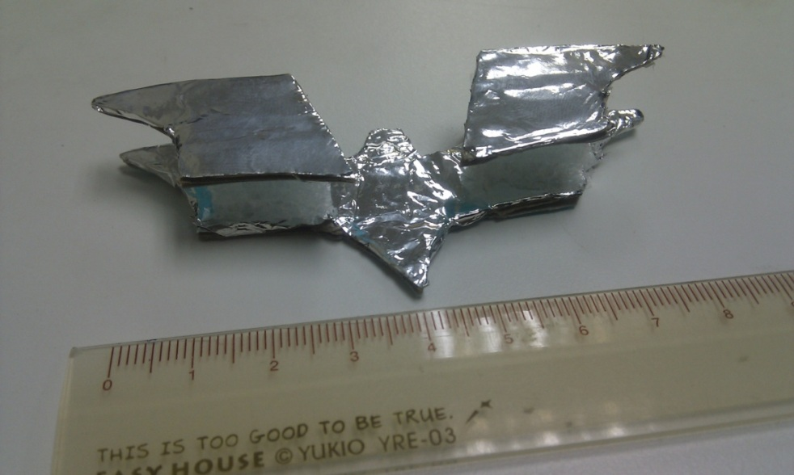
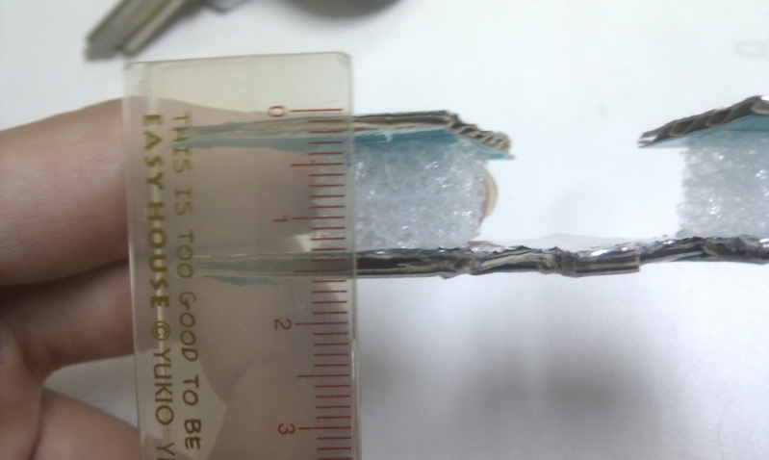

Object Image Measurement

Slide 72




Object Image Measurement

Slide 73

Table.1. Comparisons of Different MMW Radar Systems
Benchmark of MMW Radar Imaging
[2] K. B. Widener, and J. B. Mead, “W-band ARM Cloud Radar-Specifications and Design” Fourteenth ARM Sci. Team Meeting Proc., Albuquerque, New Mexico, USA, March, 2004.
[3] P.-S Tsai, and S. Frasier, “The UMass Mobile W-band Radar: System Overview and Sample Observations” 24th Conference on Severe Local Storms, Savannah, Georgia, USA, June, 2008, P13.5
[4] R. W. McMillan, C. W. Trussell, Jr. R. A. Bohlander, J. C. Butterworth, and R. E. Forsythe, “An Experimental 225 GHz Pulsed Coherent Radar”, IEEE Trans. on Microwave Theory Tech., vol. 39, pp. 555-562, March, 1991.
[10] A. Y. Nashashibi, K. Sarabandi, P. Frantzis, R. D. De Roo, and F. T. Ulaby, “An Ultrafast Wide-Band Millimeter wave (MMW) Polarimetric Radar for Remote Sensing Applications”, IEEE Trans. on Geoscience and Remote Sensing, vol. 40, pp. 1777-1786, Aug., 2002.
[11] H. Essen, H.-H. Fuchs, M. Hagelen, S. Stanko, D. Notel, S. Erukulla, H. Huck, M. Schlechtweg, A. Tessmann, “Concealed Weapon Detection with Active and Passive Millimeterwave Sensors, Two Approaches” German Microwave Conference, Karlsruhe, Germany, March, 2006.
[12] H. Essen, S. Stanko, R. Sommer, W. Johannes, A. Wahlen, J. Wilcke, and S. Hantscher, “Millimeter Wave SAR for UAV Operation” Proc. Asian-Pacific Microwave Conference 2011, Melbourne, Australia, Dec., 2011, pp. 963-966.

Slide 74
2st Application: Photonic MMW Wireless Communication System

Slide 75
Why we need non-linearity (Bias Modulation) in MOF system?
High-speed PD
Optical
MMW signal
>100km
0.4km
Optical
MMW Source
DBR LASER
(1547.9nm)
Optical
Modulator
Thin-film
filter
Optical
MMW Source
(1555.2nm)
Chromatic Dispersion Induced
Inter-Symbol Interference (ISI)!!
Low-speed PD
Remote Signal Regeneration
and Upconversion!!
Data@1547.9nm
Hung-Chang Chien, Arshad Chowdhury, Zhensheng Jia, Yu-Ting Hsueh, and Gee-Kung Chang,“Long-Reach, 60-GHz Mm-Wave Optical-Wireless Access Network UsingRemote Signal Regeneration and Upconversion,” ECOC 2008, Tu.3.F.3

Slide 76
Conceptual Diagram in MOF System……
Photodiode + Antenna: Photonic Transmitter

Slide 77
Wireless Data Transmission

Slide 79



25Gbit/s Wireless Data Transmission
This Work
25Gbit/s at 93GHz
NTT 24 Gbit/s at 300GHz
Fraunhofer Institute for Applied Solid-State Physics(IAF)
15Gbit/s at 220GHz
Highest Data Rate at Lowest Carrier Frequency!!

Slide 80
Outline
Introduction
Working Principle of NBUTC-PD
High-Power and Ultrafast Modulation Characteristic
Applications for Communication and Radar Imaging
Conclusion

Slide 81
Conclusion
Higher optimum bias for near-ballistic transport in NBUTC-PD : p-type charge layer in collector
Ultra-fast switching characteristic: Field-effect to modulate electron drift-velocity (good MMW switch !!)
High Performance photonic-transmitter mixer: Good PD modeling and MMW design
Record-High error-free wireless data rate (25 Gbps) with high-power performance (~ 20mA saturation current)

Slide 82
Thanks for your attention !!

Slide 83


Shielding structure
100 um slot-width on WR-3 short-end
Substrate thickness is 70um
860um
Open-end
WR-3
Short-end
430um
Input port
Input port

Slide 84


Shielding structure
100 um slot-width on WR-3 short-end
Substrate thickness is 70um
Need to be accurate
WR-3
445 um
455 um
100 um
Input port
Short-end

Slide 85



Passive Circuit
PD
SideView
(Should be blocked by metal)
Top View
Device

Slide 86
Passive Circuit
PD
SideView
Top View
Device
Will be cut away
Will be cut away

Slide 87
860um
Open-end
WR-3
Short-end
430um
View
PD
Input port

Slide 88
5* 5 um square, 300 GHz 3dB

